Slide 1

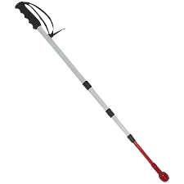
أمانك

Slide 2
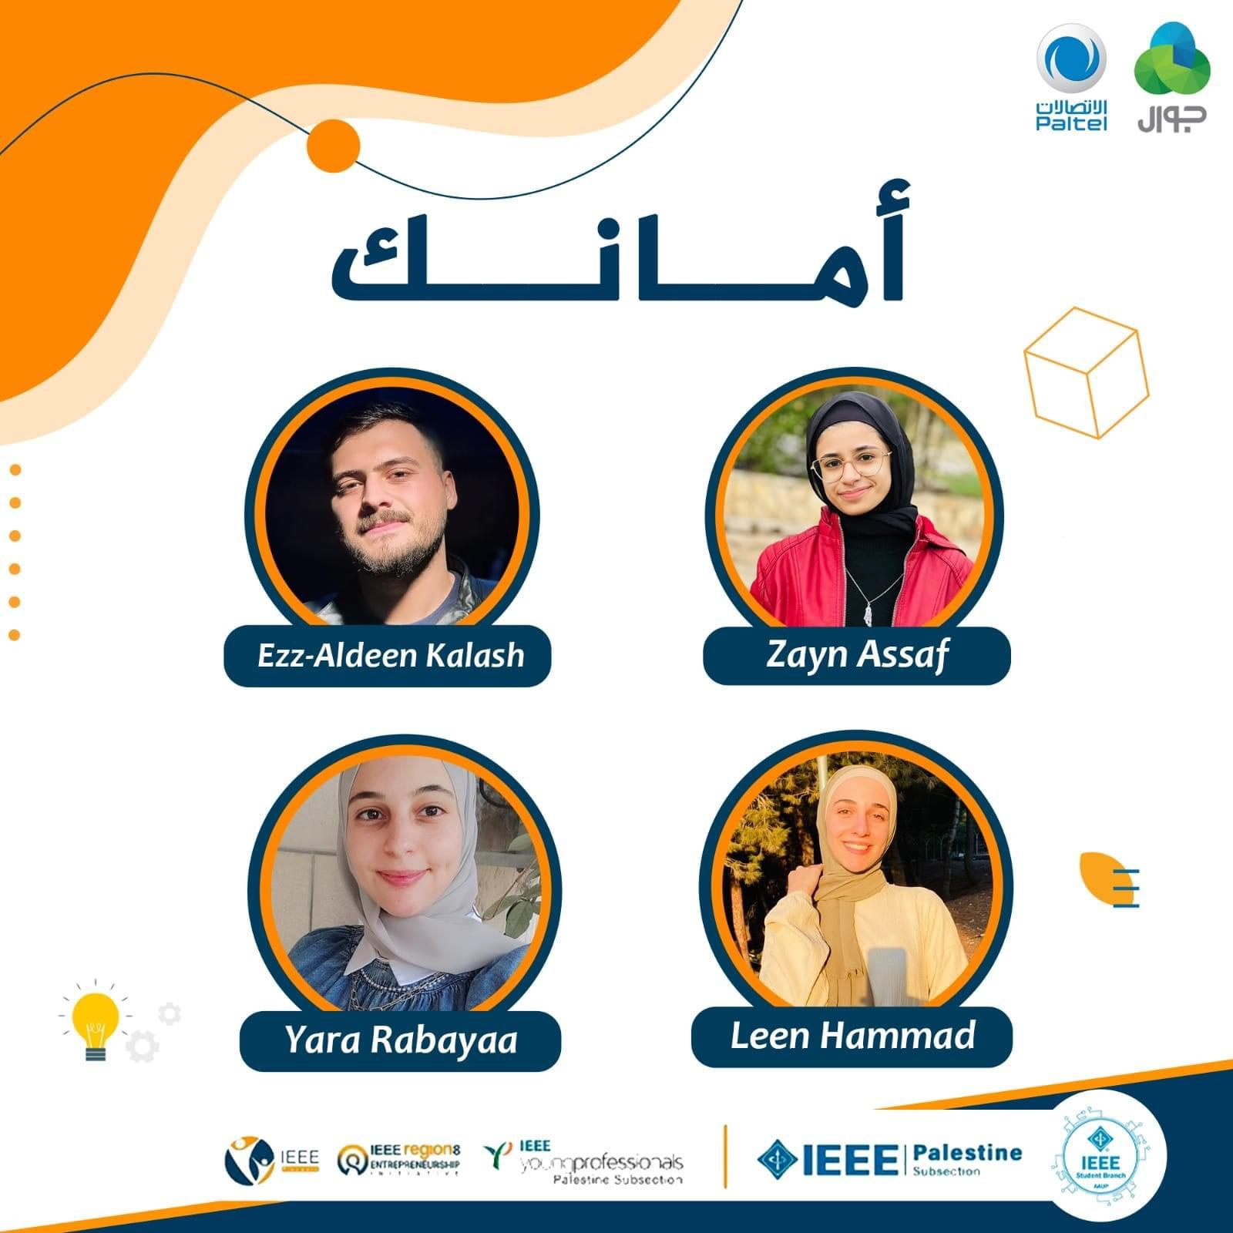

Slide 3
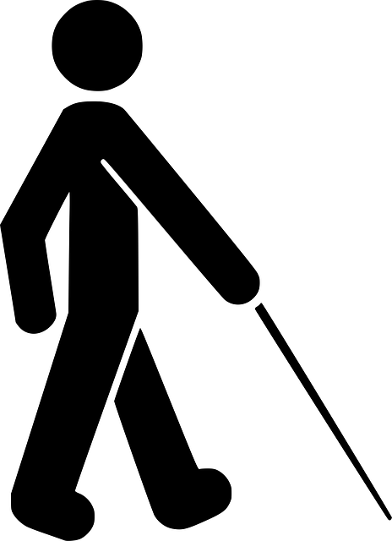
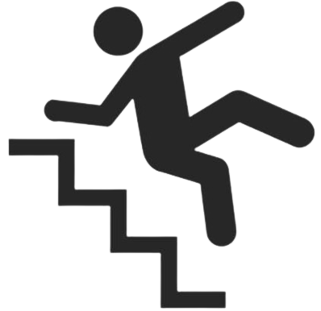

Introduction
Blindness is the inability to see anything, including light.
Erderly refers to ages nearing or surpassing the life expectancy of human beings, Which makes a person face many difficulties as a result of old age.
Both can affect physical health by increasing your risk of falls and your quality of life.
it have a big impact on:
Moving
Safety
communication

Slide 4

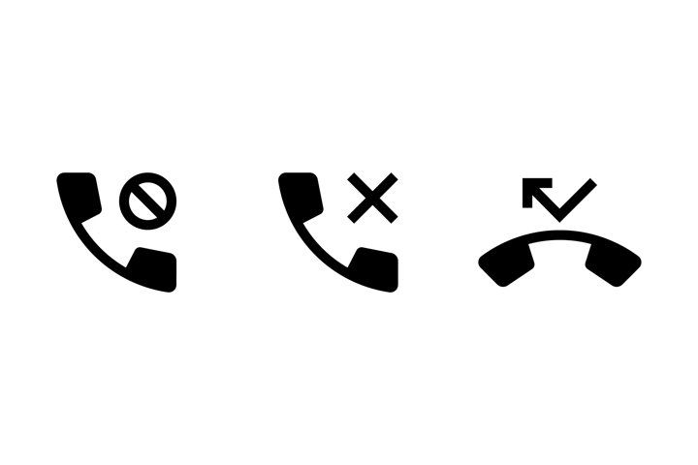

Which cause:
Family concern
Fear and anxiety of the blind and the elderly
Inability to communicate

Slide 5
The biggest obstacles that they and their families face:
risk of being lost and not being able to determine the current location
Exposure to a danger that requires, such as: (low vital signs, the need to call the police, hospital or civil defense "without complicated communication processes)
This is what made us come up with our idea to reduce these concerns and problems, through band and application associated with it:

Slide 6
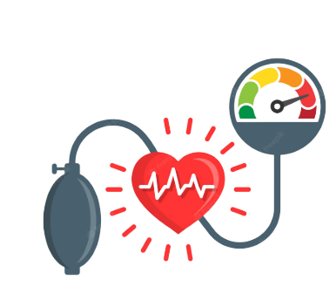
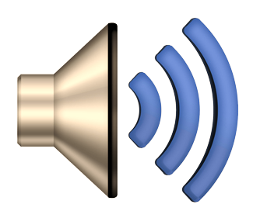
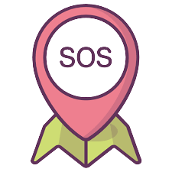
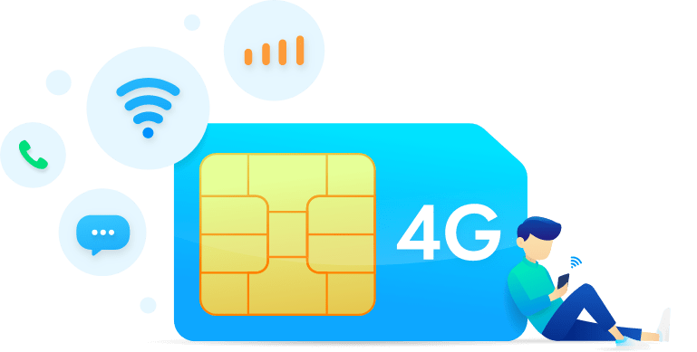
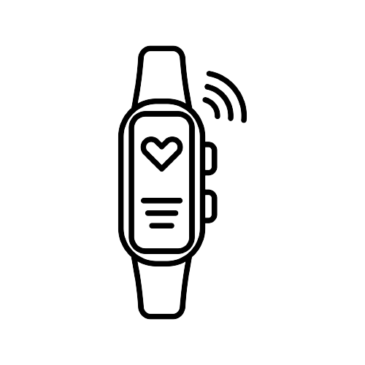
Our smart band properties:

Slide 7
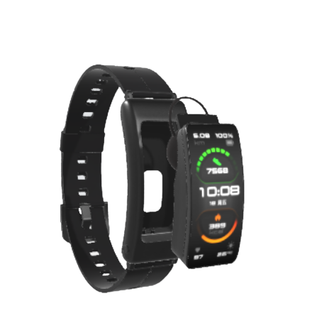
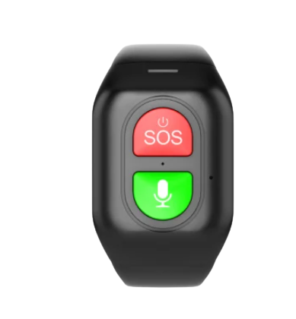
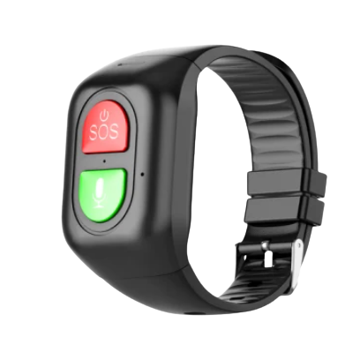
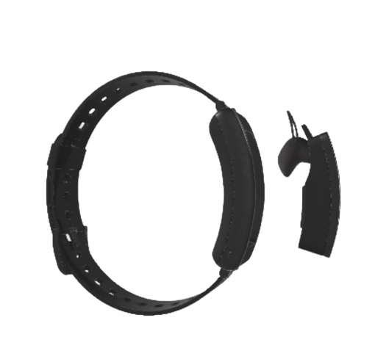
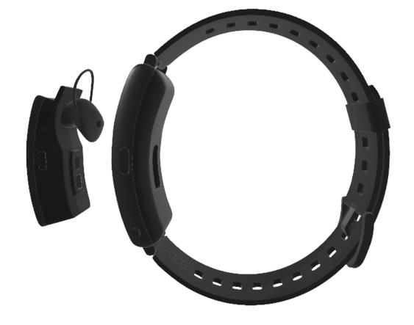
4G\2G SIM
4G\2G SIM

Slide 8
Band’s Goals
Goal 1
Goal 2
continuous measurement of vital signs, such as pressure, temperature,...etc.
Determine the location by GPS for the blind.
Goal 3
Goal 4
Detailed location information is sent to family.
Automatic emergency call, in the event of a sharp decline in vital signs

Slide 9
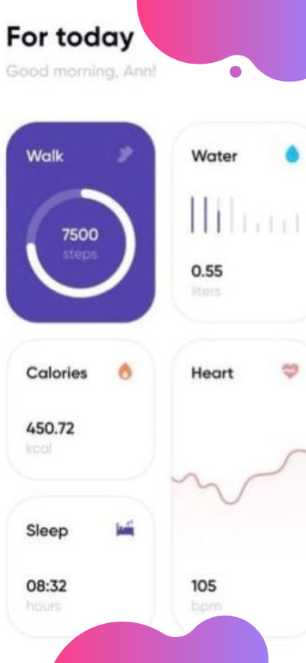
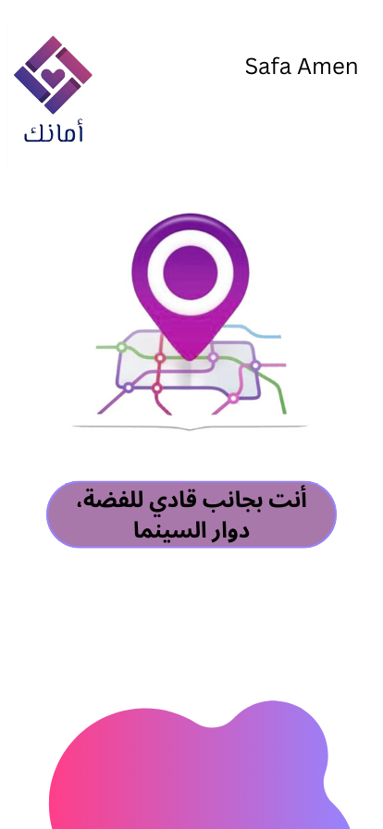
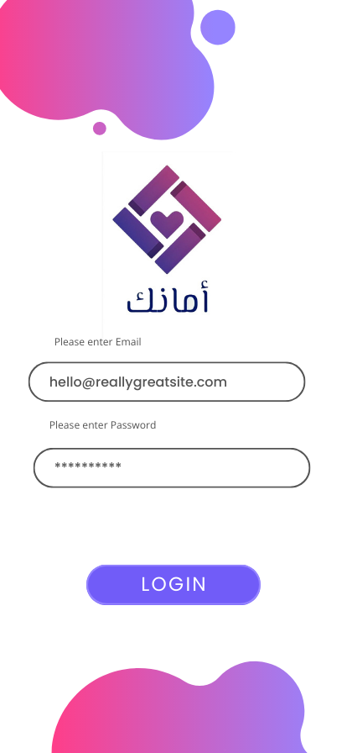

Slide 10
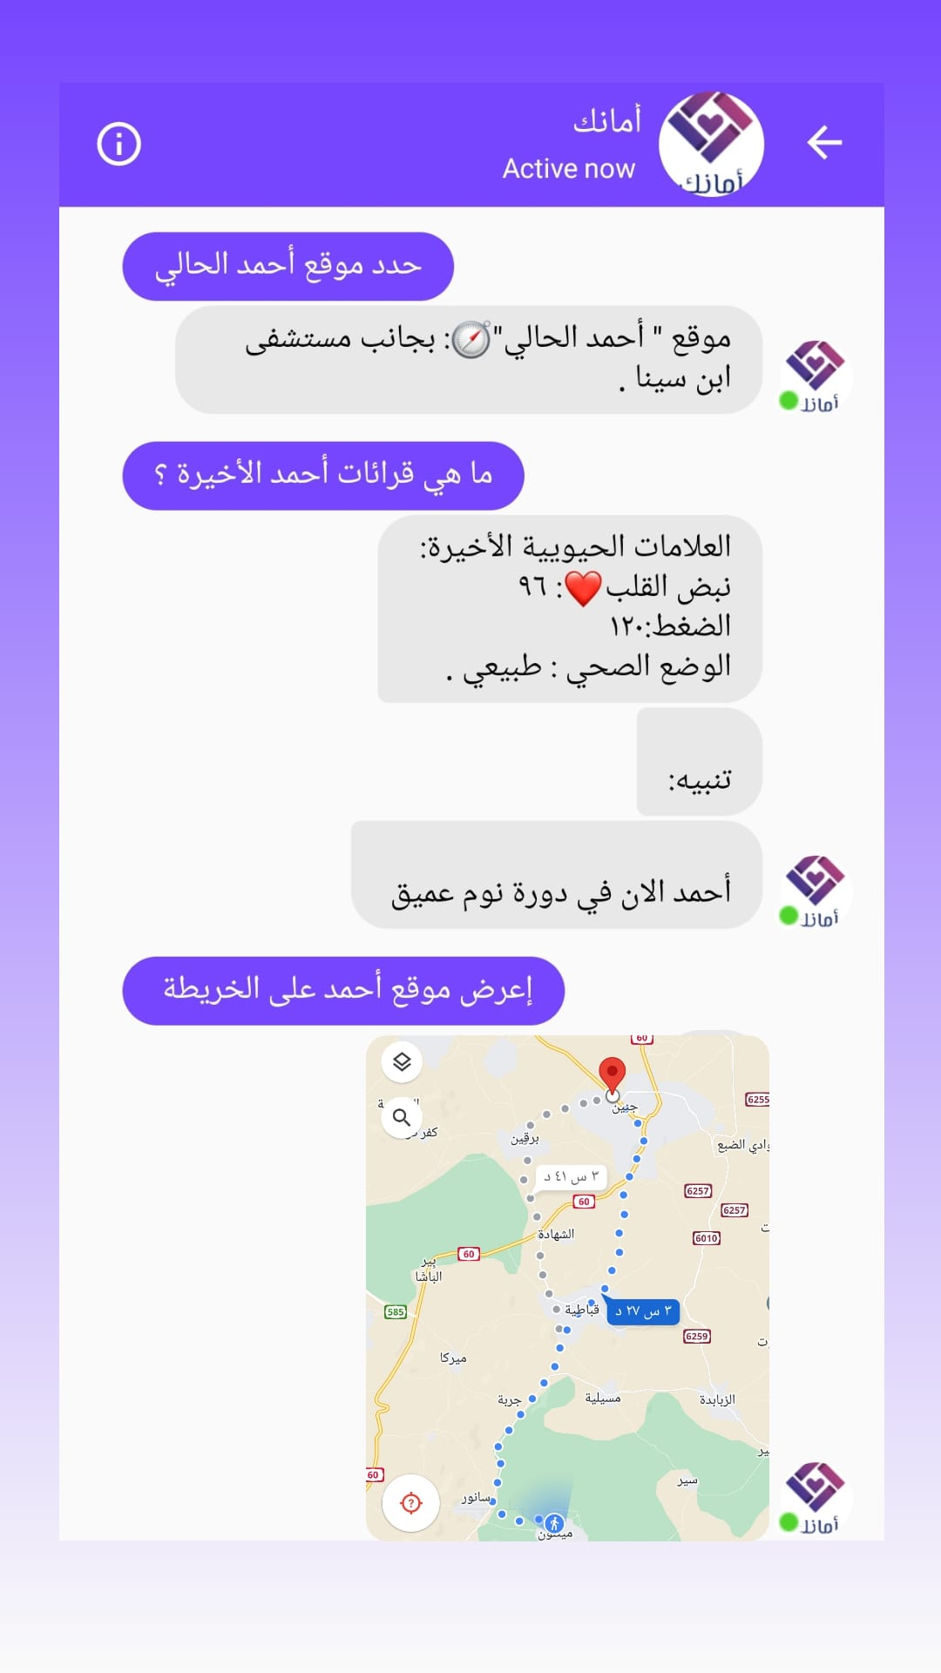
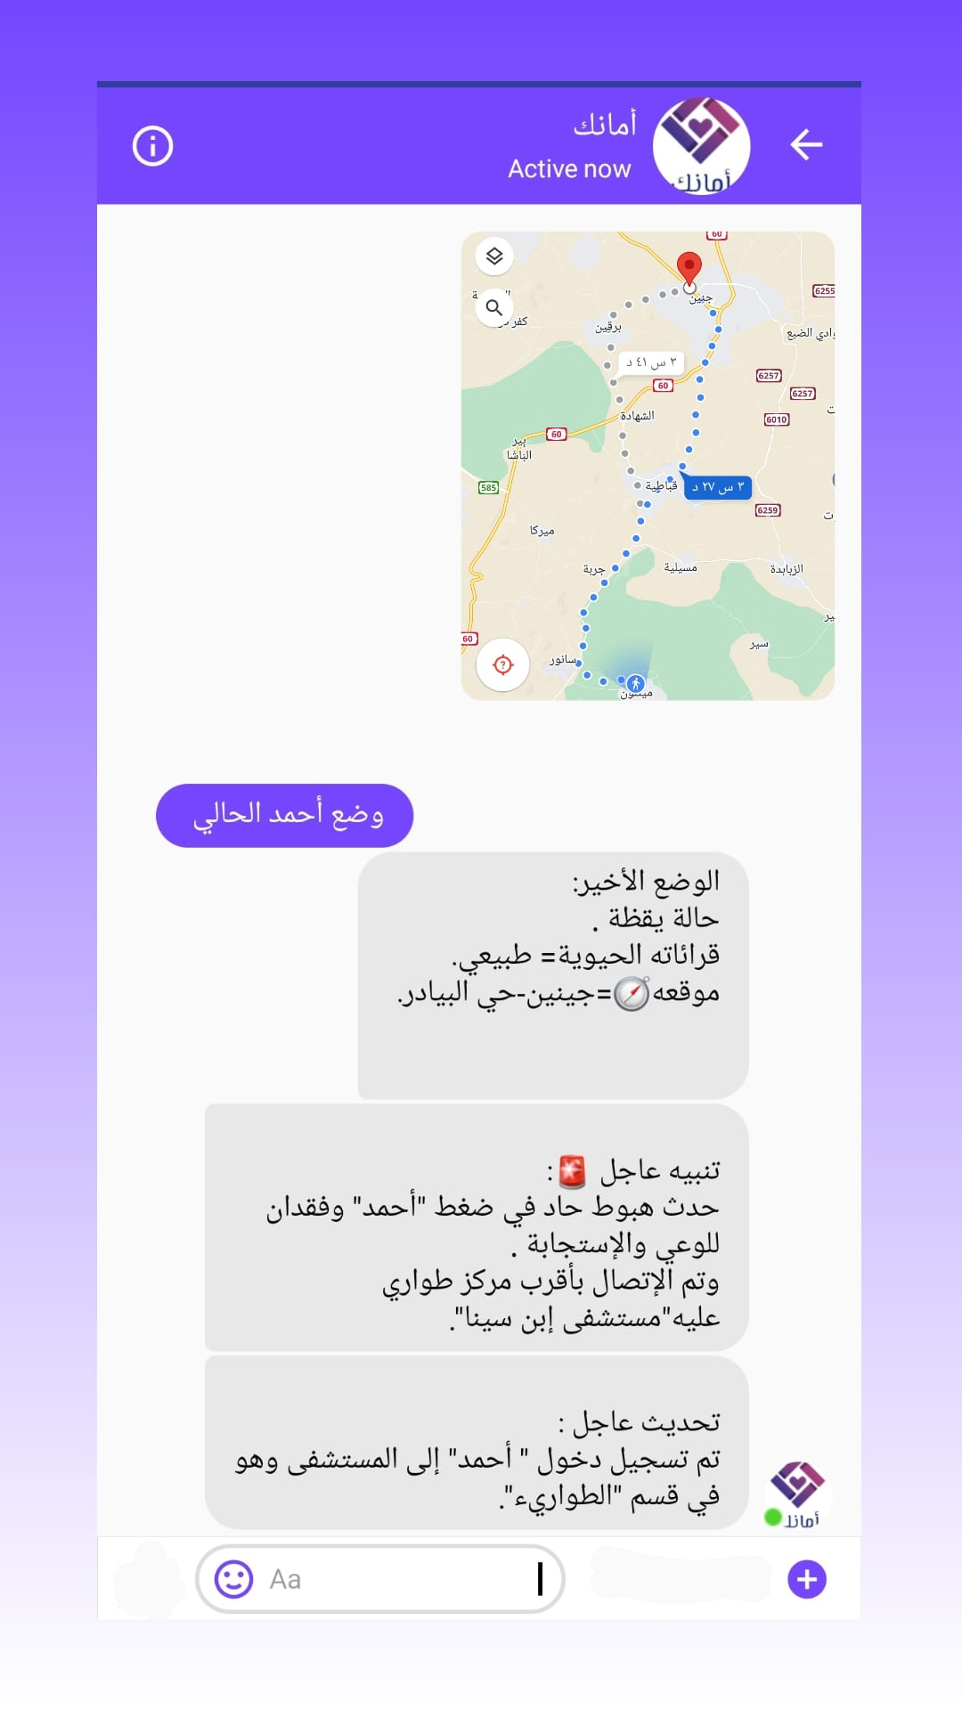

Slide 11
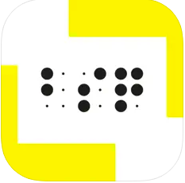
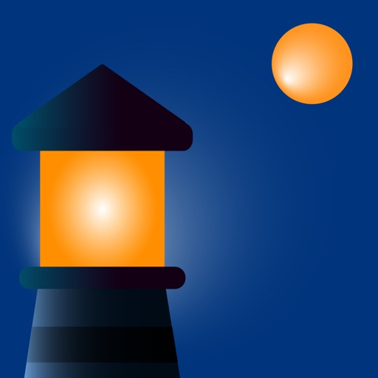
Competitive Advantages
BlindSquare
Ariadne GPS

Slide 12
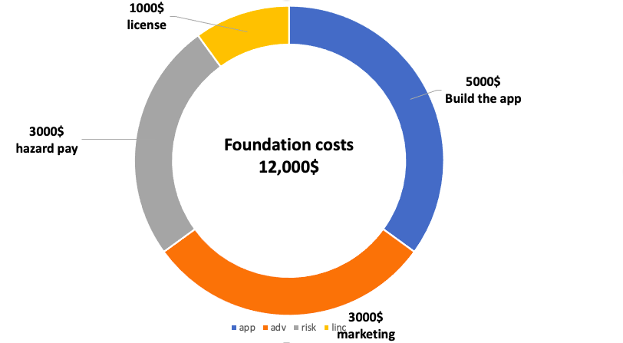
Cost structure:
Foundation Costs
Operational Costs
$30
Bracelet Cost
25%
Marketing
15%
Taxes
10%
Application updates

Slide 13
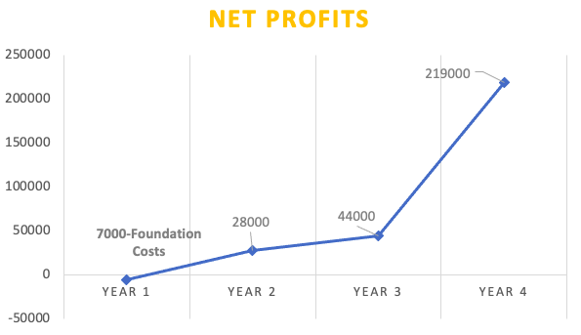
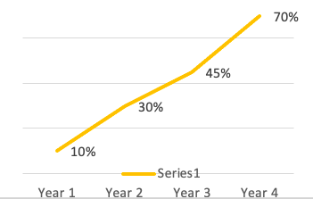
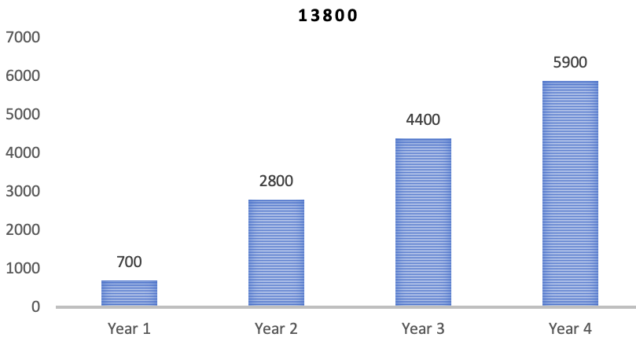
profits
80$
For each user
Include
( bracelets + app )
13800
User in 4 Years
From Ad Space
Advertiser ratio
In Palestine, there are 28,950
blind and half blind people

Slide 14

ابتكار فلسطيني وبأيادي حرة .

